Slide 1
Naloxone Code-A-Thon
Approved Formulations of Naloxone
October 19, 2016
Jennifer Nadel, MD
Medical Officer
FDA/CDER/OND
Division of Anesthesia, Analgesia, and Addiction Products

Slide 2
Naloxone Overview
Naloxone is a nonselective opioid receptor antagonist, that is, it reverses the effects of an opioid when given in a timely manner
Naloxone should be used emergently in opioid overdose to reverse the life-threatening effects including coma
When administered quickly, naloxone can prevent injury and death

Slide 3
Overview of Naloxone
Initially approved in 1971 as Narcan with subsequent approvals of generic products
Initially intended for use in a healthcare setting
Labeled for intravenous (IV), intramuscular (IM), or subcutaneous (SC) use
Dose is 0.4 to 2 mg
May repeat dosing at 2 to 3 minute intervals
Original Narcan injectable formulation

Slide 4
Naloxone Strengths and Presentations
Generics to the original Narcan injection are available
0.4 mg/ml: Single-dose (1 ml) and multiple-dose (10 mL) prefilled vials
1 mg/ml: Single-dose (2 ml)
These are usually used in hospitals and on ambulances
The healthcare professional prepares the naloxone for injection

Slide 5
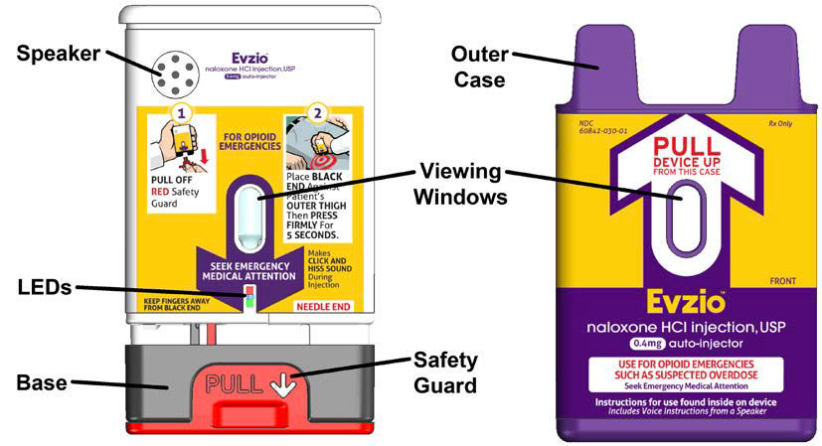
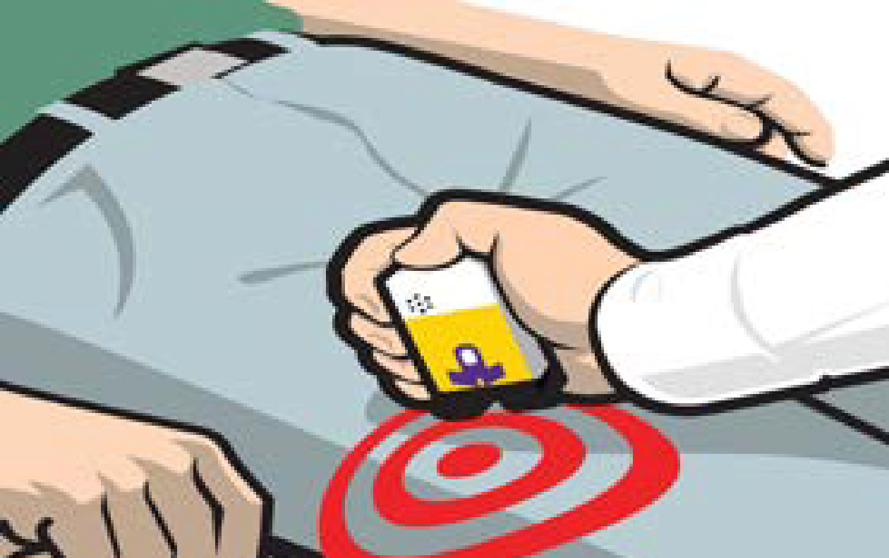
Evzio
Naloxone auto-injector
First naloxone product approved for use in the community
Delivers a 0.4 mg dose
Administered into the upper outer area of the thigh and can be given through clothing
Packaged with 2 single-use auto-injectors and a trainer with verbal instructions
From the Evzio label

Slide 6
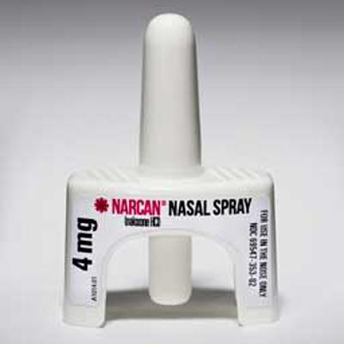
Narcan Nasal Spray
Labeled for intranasal use
Delivers a 4 mg dose in a 0.1 ml nasal spray
Packaged with two single-use devices
www.narcan.com

Slide 7
Indications for Community Use Naloxone
The emergency treatment of known or suspected opioid overdose, as manifested by a decrease in breathing and/or alertness
Intended for immediate administration as emergency therapy in settings where opioids may be present
Not a substitute for emergency medical care; must also call 911
Approved with Instructions for Use
Patient labeling targeted to the layperson
Expected that laypersons can use without any additional training required

Slide 8
Adverse Effects of Naloxone
In a person who has had long-term use of an opioid (prescription or illegally obtained), naloxone may cause withdrawal symptoms, such as body aches, diarrhea, rapid heart rate, vomiting, abdominal cramps, and increased blood pressure

Slide 9
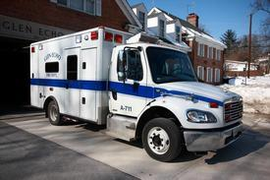
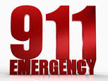
Additional Considerations
Effects of naloxone can wear off before the opioid, so:
Patients require continued monitoring and sometimes repeat dosing of naloxone
Emergency medical care should be sought immediately
www.greenbrierpolice.com
http://www.gefd.org/galleries/apparatus

Slide 10
How Can Naloxone be Obtained?
Prescription from a physician
Community outreach programs
Certain states have taken steps to make naloxone more available, such as establishing standing orders or collaborative practice agreements
In many instances, first responders are using naloxone intended for injection off-label via intranasal administration
In some areas of the country high-risk prisoners are being released with a naloxone product when they leave prison

